Slide 1
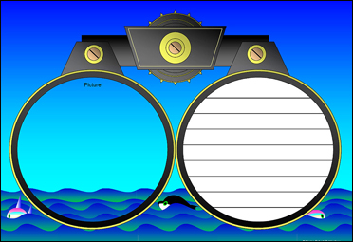
Annotating Text to Deepen Understanding
Doug Fisher
and
Nancy Frey

Slide 2
Annotation is a note of any form made while reading text.
“Reading with a pencil.”

Slide 3
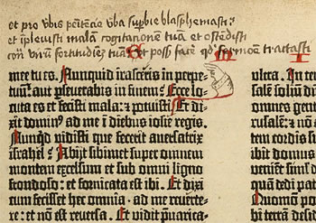
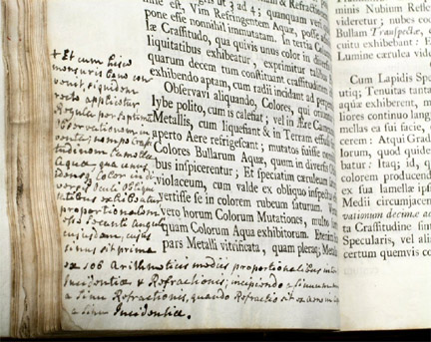
People have been annotating texts since there have been texts to annotate.

Slide 4
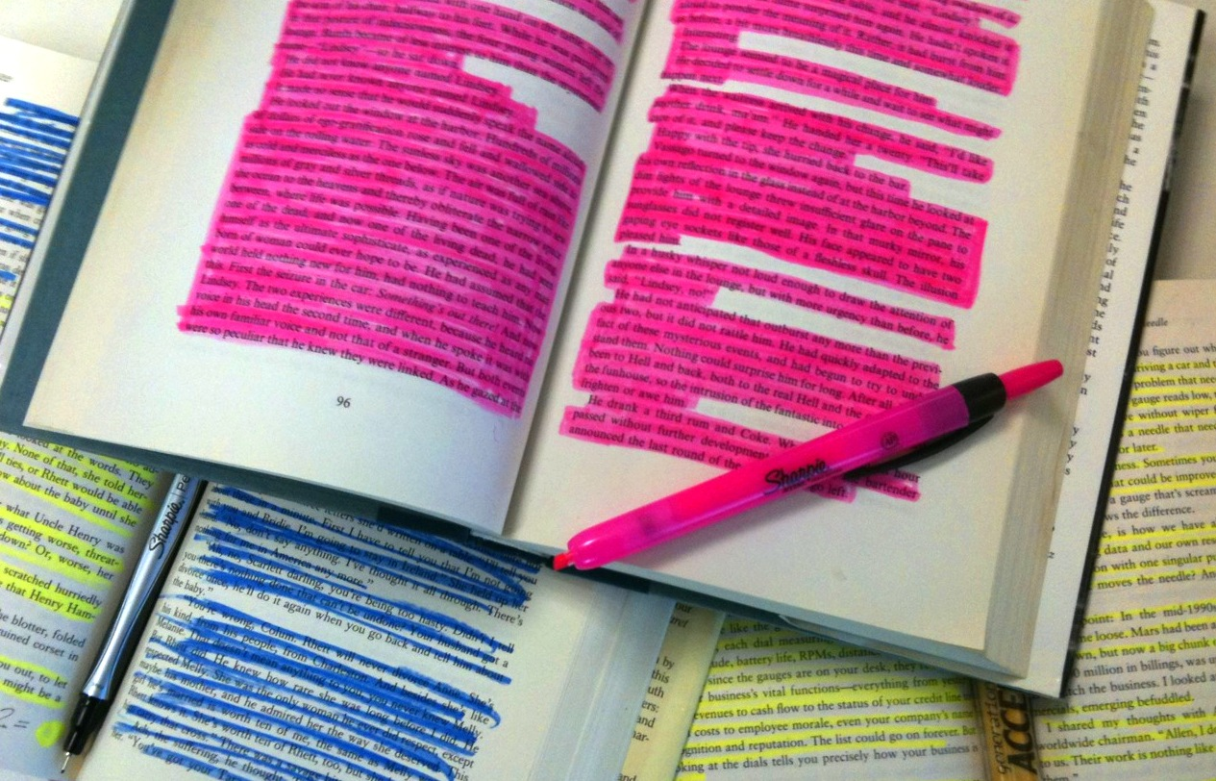
Annotation is not highlighting.

Slide 5
Annotation slows down the reader in order to deepen understanding.

Slide 6
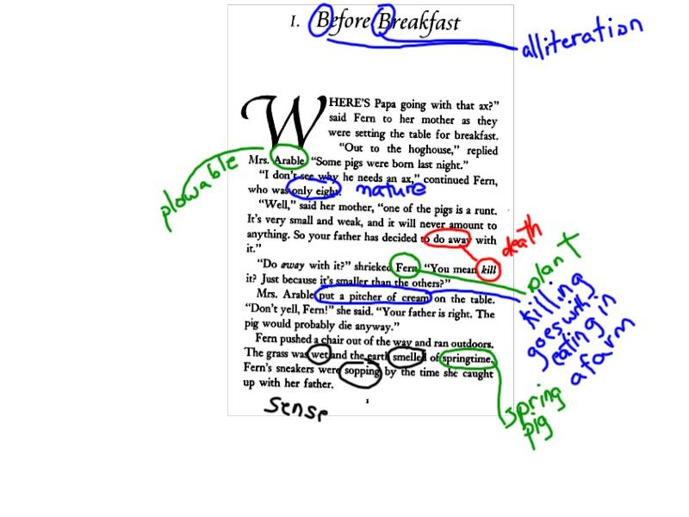
Student’s annotation of connotative meanings in Charlotte’s Web
Notes:
It’s not always about reading difficult texts, but also about reading seemingly simpler texts in more complex ways.

Slide 7
Annotations We Use
Circle words that are confusing or unknown to you.
Use a question mark (?) for questions that you have during the reading. Be sure to write your question in the margin of your paper.
Use an exclamation mark (!) for things that surprise you, and briefly note what it was that caught your attention.
Draw an arrow (↵) when you make a connection to something inside the text, or to an idea or experience outside the text. Briefly note your connections.

Slide 8
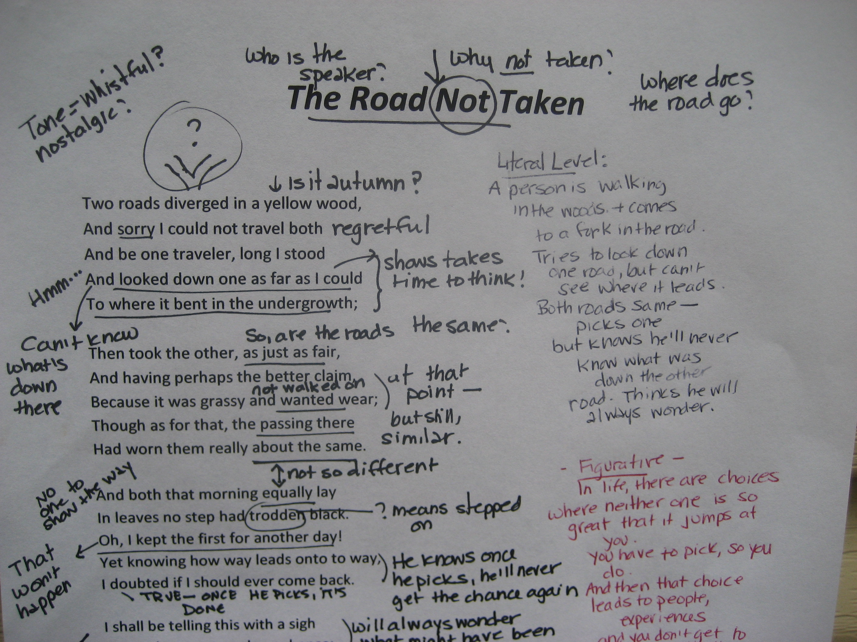
Modeling in 10th Grade English

